Slide 1


Lucas Motta
January 27th, 2025

Slide 2

Outline
Executive Summary
Introduction
Methodology
Results
Conclusion
Appendix

Slide 3
Executive Summary
Data collection through API and Webscraping
Data Wrangling
EDA through data visualization
EDA through SQL
Interactive plots and dashboards
Predictive analysis
Tuned parameters for Logistic Regression, SVM, Decision Trees and KNN
Accuracy and confusion matrix for each model to define the best one

Slide 4
Introduction
SpaceX proposed to lower the cost of spaceship launches by recovering the first stage (the most expensive piece)
This was attained through tests and iterations
Right now, the company is at a point where there are sufficient data to implement predictive analysis and complement the engineering studies to grow the rate of success
This means using data to answer the question:
“Given a collection of known features and the outcome of past launches, can I use this information to predict the possible success of a future mission?”

Slide 5

Section 1

Slide 6
Methodology
Executive Summary
Data collection methodology:
Describe how data was collected
Perform data wrangling
Describe how data was processed
Perform exploratory data analysis (EDA) using visualization and SQL
Perform interactive visual analytics using Folium and Plotly Dash
Perform predictive analysis using classification models
How to build, tune, evaluate classification models

Slide 7
Data Collection
Datasets were collected through two processes:
SpaceX API call
Falcon 9 Wikipedia page webscraping
Both processes can be summarized as follows:
External call (API or URL)
Data parsing
Select and filter desired data from call
Clean data and create the Dataset
Save dataset on a CSV file

Slide 8
Data Collection – SpaceX API
The API data collection was done through the following steps:
API GET request and response parsing
Normalized Json to a Dataframe
Filter data to collect desired input
Use data to build a data frame
Filter data frame to include only Falcon 9 launches
The full notebook can be found here: API call
API Data collection Flow Chart
SpaceX API GET request
Filter data to include only Falcon 9 launches
Json response parsing
Specify columns to filter the DataFrame
Json response normalized to DataFrame
Apply functions to extract info from DataFrame
Create dataset using obtained data
Create lists to be filled with DataFrame info

Slide 9
Data Collection - Scraping
The Webscraping for data collection was done through the following steps
Falcon 9 Launches request from Wiki Page’s URL
Column names’ extraction from tables
Data Frame creation by HTML tables parsing
The full notebook can be found here: Webscraping
Webscraping Data collection Flow Chart
Create dataset using obtained data
URL request
Create data frame with HTML tables parsing
Apply given functions to extract info from DataFrame
Extract column names from tables

Slide 10
Data Wrangling
To better understand data and work with it the following steps were performed:
Replace missing values for ‘Payload Mass’ with the average value (on API data)
Check each column’s type
Check and describe unique values for the following columns:
Launch Site
Orbit
Mission outcome
Create a column called ‘Class’ where:
0 – First stage did not land successfully
1 – First stage landed successfully
GitHub file for Data Wrangling

Slide 11
EDA with Data Visualization
In the project 7 charts were plotter:
A scatter plot of Flight Number vs Payload Mass hued by Launch Outcome.
A scatter plot of Flight Number vs Launch Site hued by Launch Outcome.
A scatter plot of Pay Load Mass across Launch Sites hued by Launch Outcome.
A bar chart of Success rate by orbit type.
A scatter plot of Flight Number vs Orbit Type hued by Launch Outcome.
A scatter plot of Pay Load Mass vs Orbit Type hued by Launch Outcome.
A line plot of Success rate over time.
GitHub URL of completed EDA with data visualization

Slide 12
EDA with SQL
The SQL queries performed were:
The unique Launch Sites in the space mission
5 records where Launch Sites begin with the string ‘CCA’
The total Payload Mass carried by boosters launched by NASA (CRS)
The average Payload Mass carried by booster version F9 v1.1
The date when the first successful landing outcome in ground pad was achieved
The names of the boosters which have success in drone ship and have Payload Mass greater than 4000 but less than 60000
Total number of successful and failed mission outcomes
The names of booster versions which have carried the maximum Payload Mass
Records which will display the month names, failure Landing Outcomes in drone ship ,booster versions, launch site for the months in year 2015.
Count of landing outcomes (such as Failure (drone ship) or Success (ground pad)) between the date 2010-06-04 and 2017-03-20, in descending order.
GitHub URL of completed EDA with SQL

Slide 13
Build an Interactive Map with Folium
In folium, the following items were created:
A map with a marker for each Launch Site. So, it was easy to spot where in the country these Launch Sites are located and how close to each other;
A Marker Cluster with markers for each success/failed launch for each site;
A mouse position box with Latitude and Longitude being indicated, so it would be possible to pinpoint two locations and calculate the distance between them;
The previous information was used to insert a line with the distance from the nearest coastline;
The same process could be performed to add markers were to check how close the launch sites are from railroads, city, highways, etc.
GitHub URL of completed interactive map with Folium map

Slide 14
Build a Dashboard with Plotly Dash
The interactive Dashboard shows the following:
A dropdown list with either “All sites” or each separated Launch Site to be selected:
This list filters the information to be shown in the Pie Plot of Total Success rate
This way it is possible to visualize the sites with the highest success rate
A ranger slider to select a range of Payload Mass and show a scatter plot of payload vs booster class for either “All sites” or the selected site on the dropdown
GitHub URL of completed Plotly Dash lab

Slide 15
Predictive Analysis (Classification)
To built, evaluated, improved, and found the best performing classification model, the following steps were performed:
Break data set into Independent Variables (X) and Target (Y)
Split the data set into Train and Test
Perform the steps below for different algorithms (Logistic Regression, SVM, Decision Tree, KNN)
Define the parameters to be used in the GridSearchCV method
Capture the best parameters and use it to make the prediction (yhat) using the test set (X_test)
Compare predictions (yhat) made with the real data (Y_test)
Select the algorithm with the smallest error.
GitHub URL of completed predictive analysis lab

Slide 16
Results
Exploratory data analysis results
An overview of data gave a good understand on the features and how the progress was obtained over time
Features like Payload Mass and Orbit Type provided good insight. For instance, over time stage 1 modules became bigger and the success rate increased. There are specific Orbit Types where the rate of success is higher and a range of sizes that didn’t show good results
Interactive analytics demo in screenshots
The visualizations helped going through the analytical data and extract those insights
Predictive analysis results
The models showed good results for predicting true success. They showed some problems when predicting failure. Further analysis could be taken to tune the model.

Slide 17

Section 2

Slide 18
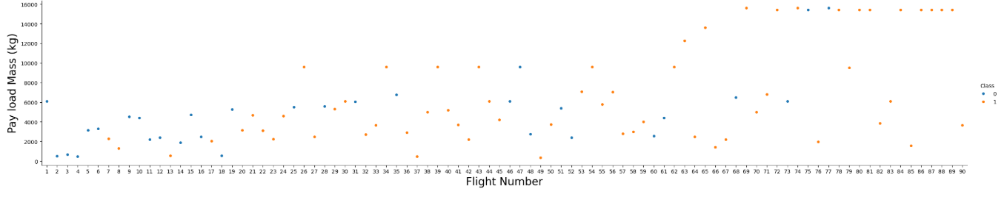
Flight Number vs. Pay Load Mass
This plot shows that over time the Pay Load Mass grew bigger and the rate of success too.
For smaller cases the rate of success got better, but even then, the failed attempts seem concentrated on smaller ships.

Slide 19
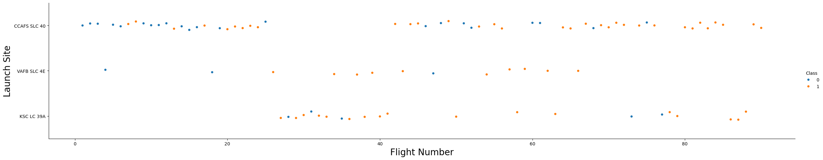
Flight Number vs. Launch Site
This plot shows how the success rate grew with time and across sites. The first site had a lot of failed attempts and once it started to have some success, expansion to other sites began.

Slide 20
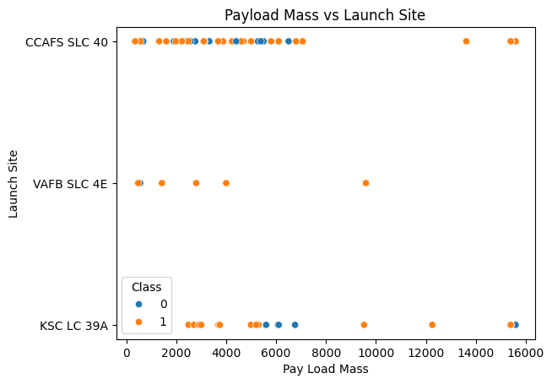
Payload vs. Launch Site
For CCAFS SLC 40 – the rate of success is somewhat fuzzy, with good indicators for heavy loads (14k+)
For VAFB SLC 4E – There’s a good rate of success. Although the number of launches is smaller
For KSC LC 39A – Around 6k there are some failures, but, other than that there’s a good rate of success

Slide 21
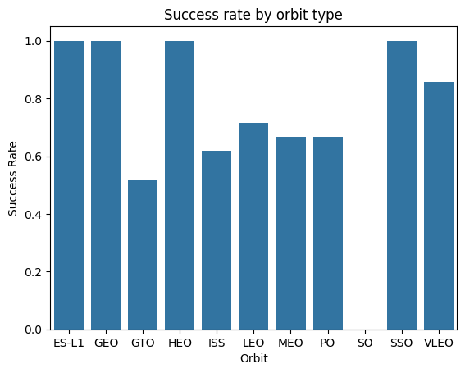
Success Rate vs. Orbit Type
The bar plot shows a great rate of success for some Orbit Types (ES-L1, GEO, HEO, SSO). However, further analysis might be needed, as shown on the next slides.

Slide 22
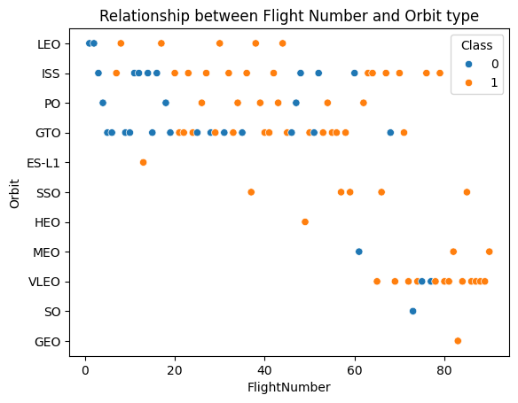
Flight Number vs. Orbit Type
As stated on the previous slide there are some Orbits with high rate of success, however, SSO is the only Orbit with more than one launch.
The plot also shoes that, generally, over time

Slide 23
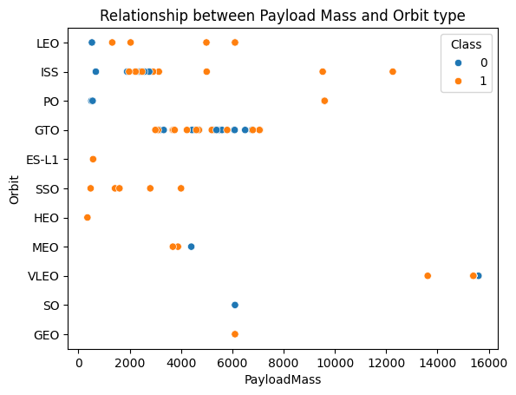
Payload vs. Orbit Type
The plot shows that, across orbits, there’s a range of Pay Load Mass where failure is most likely. The outlier is SSO where small Payloads obtained success.

Slide 24
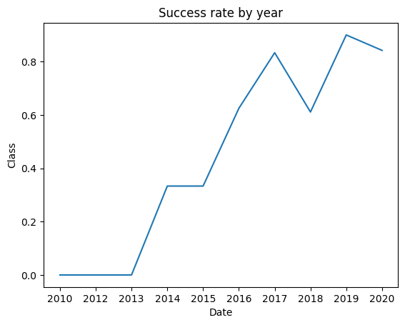
Launch Success Yearly Trend
Plot shows that with time, success rate grew without a doubt.

Slide 25
All Launch Site Names
The unique launch sites are:
CCAFS LC-40
VAFB SLC-4E
KSC LC-39A
CCAFS SLC-40

Slide 26
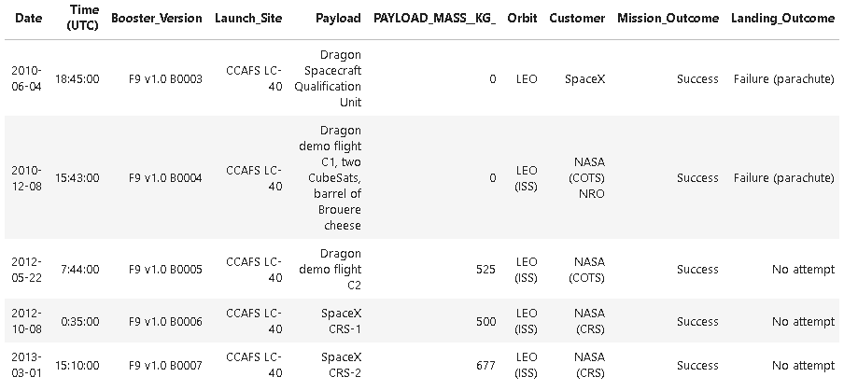
Launch Site Names Begin with 'CCA'
The 5 records where launch sites begin with ‘CCA’ are

Slide 27
Total Payload Mass
The total payload carried by boosters from NASA is
NASA (CRS) 45596 Kg

Slide 28
Average Payload Mass by F9 v1.1
The average payload mass carried by booster version F9 v1.1 is 2928.4 Kg

Slide 29
First Successful Ground Landing Date
The dates of the first successful landing outcome on ground pad was 12/22/2015

Slide 30
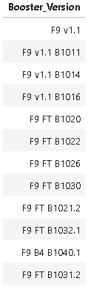
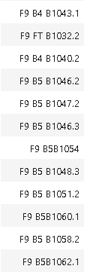
Successful Drone Ship Landing with Payload between 4000 and 6000
The names of boosters which have successfully landed on drone ship and had payload mass greater than 4000 but less than 6000

Slide 31
Total Number of Successful and Failure Mission Outcomes
The total number of successful and failure mission outcomes
Failure (in flight) 1
Success 99
Success (payload status unclear) 1

Slide 32
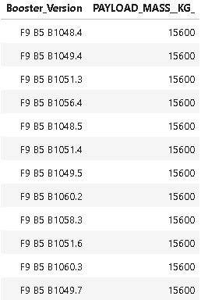
Boosters Carried Maximum Payload
Names of the booster which have carried the maximum payload mass

Slide 33
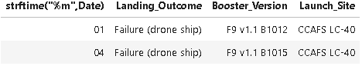
2015 Launch Records
List the failed landing_outcomes in drone ship, their booster versions, and launch site names for in year 2015

Slide 34
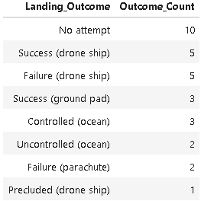
Rank Landing Outcomes Between 2010-06-04 and 2017-03-20
Rank the count of landing or Success between the date 2010-06-04 and 2017-03-20, in descending order

Slide 35

Section 3

Slide 36
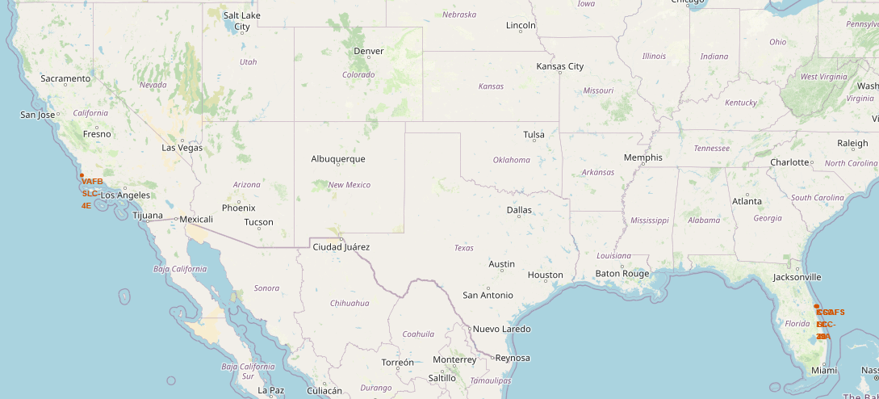
Launch Sites across US
The sites are quite distant from each other, but in all cases, they are close to the coast.

Slide 37
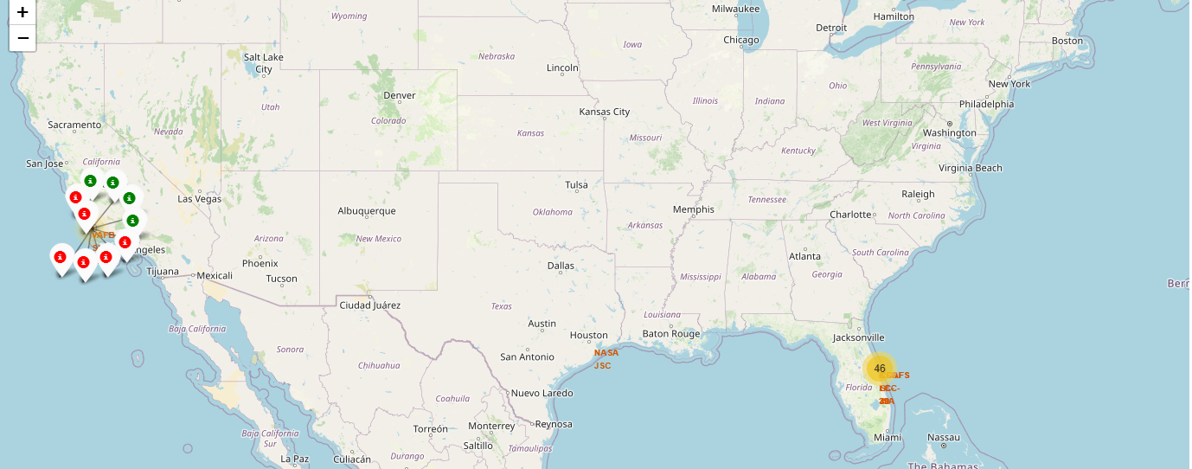
Launch clusters with marks of Success/Failure
This plot helps in visualizing the rate of success across Launch Sites. In the screenshot it is possible to see that, for the pinpointed site, the rate of success isn’t high.

Slide 38
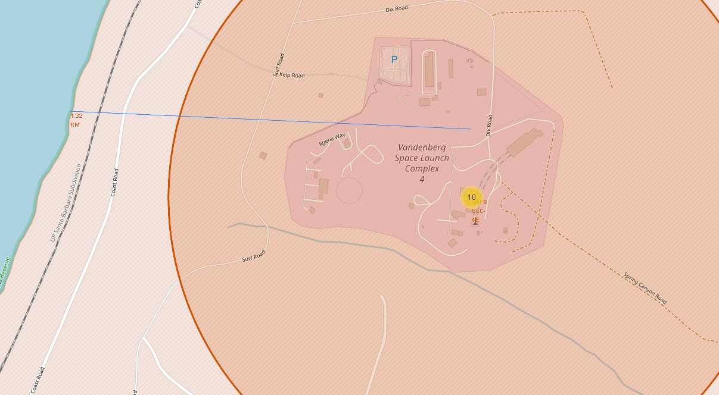
Distance from Launch Site to Coast Line
The calculated distance is 1.32 Km

Slide 39

Section 4

Slide 40
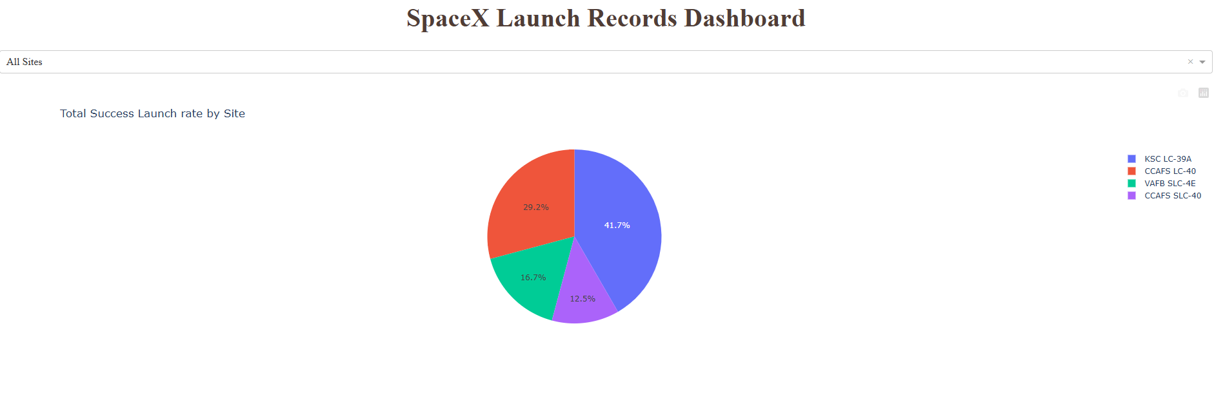
Launch Success count for all charts
The success rate across sites is significantly different. A thorough study should be performed to understand what is impacting those rates.

Slide 41
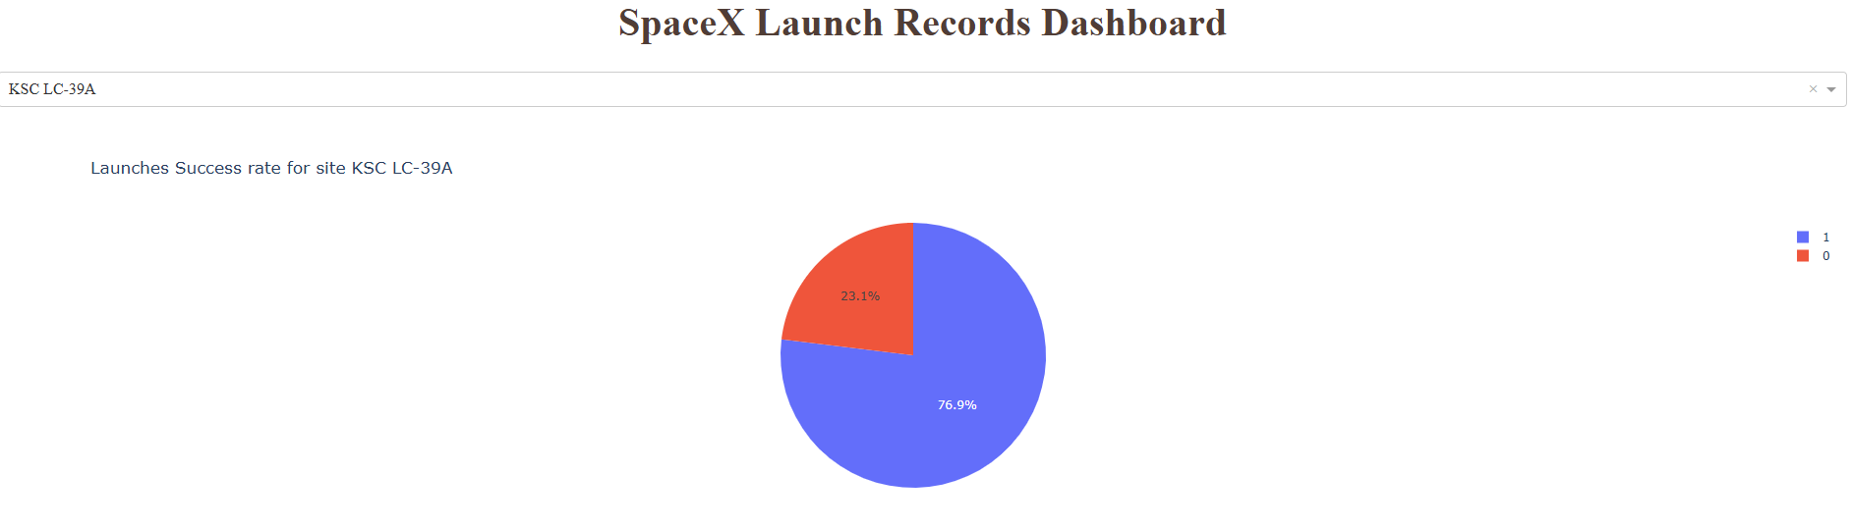
Plot for the Site with largest Success Rate
KSC LC-39A is the Launch Site with the highest success rate

Slide 42
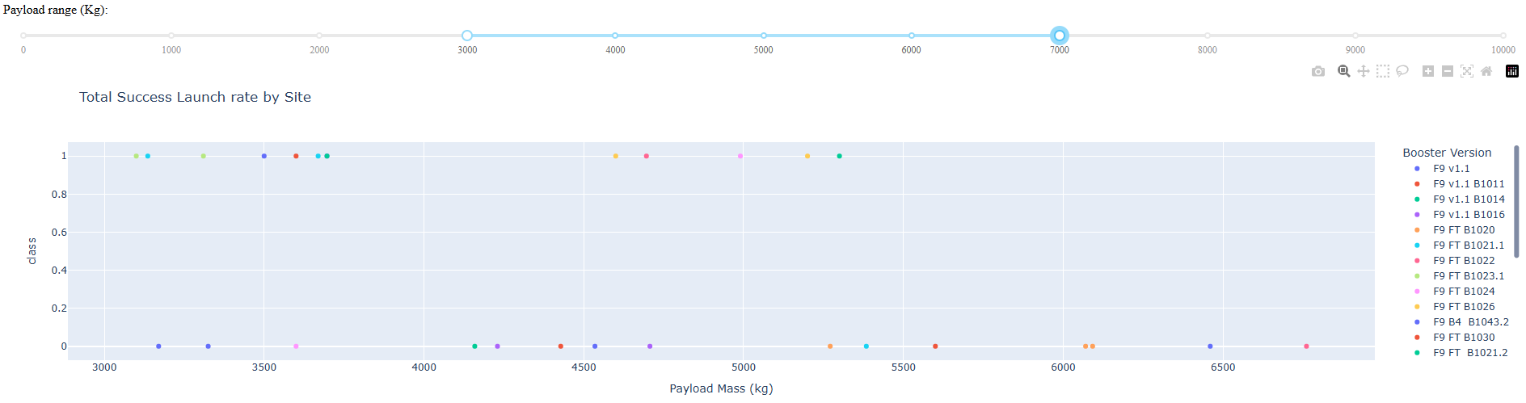
Total Success Launch rate by Site and Payload Mass
Honestly, I didn’t find this plot very useful. It has so many colors it is difficult to take any insight from it.

Slide 43

Section 5

Slide 44
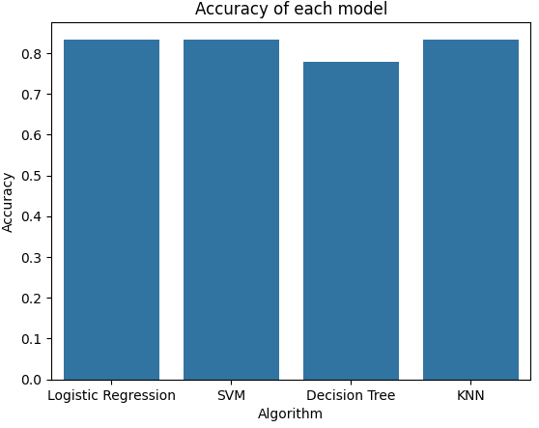
Classification Accuracy
On test data Logistic Regression, SVM and KNN have the same accuracy of 83%

Slide 45
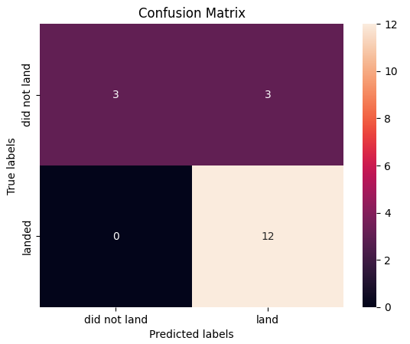
Confusion Matrix
Models showed good results for predicting true positives (i.e. success cases) but failed to predict failure.

Slide 46
Conclusions
Logistic Regression, SVM and KNN took way less time and had better accuracy than Decision Tree
All models had difficulty to predict failure. This highlights the need for refinement either in data and/or the model.
The business is at a point of development where failure isn’t that common, so, the model is useful. It is necessary to know that failure predictions need to be thread lightly.

Slide 47


